Slide 1

MICROWAVE OVEN SIMULATOR
Presented by
SAJITH P
ECE
CMS College
of Engineering and
Technology coimbatore

Slide 2
TOPICS
What we learned during internship
Description of project
Functional requirements
Interfacing
Project demonstration

Slide 3
WHAT WE LEARNED DURING INTERNSHIP
Introduction to C
Conditional, loops and operators
Arrays and Pointers
Functions and Strings
Storage classes
Introduction to Embedded systems and microcontrollers
MPLAB IDE,XCB,PICSimlab
Introduction to various peripherals of PIC16F877A
Interfacing various peripherals of PIC16F877A

Slide 4
DESCRIPTION OF PROJECT

Slide 5
MICROWAVE OVEN SIMULATOR
Power ON
On turning the Microwave oven ON, the oven display need to display the power ON message.
Cooking Modes
1.Micro mode
2.Grill mode
3.Convection mode
4.start
Set time/temperature
The user need to set the time or temperature
Issue warnings
The oven need to warn the user incase of invalid time/temperature or the door is opened
End
The oven need to display “cooking time up” message on completion of cooking mode

Slide 6
FUNCTIONAL REQUIREMENTS

Slide 7
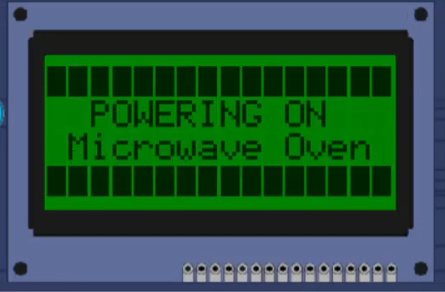
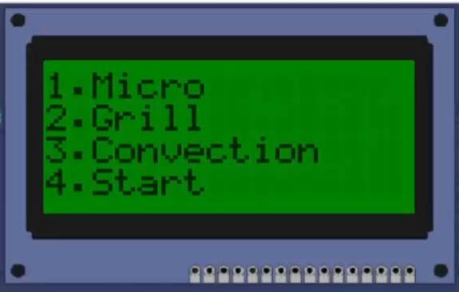
On powering ON the microwave oven, the CLCD displays the power on message which is followed by display of four different cooking modes

Slide 8
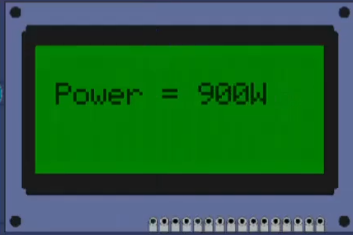
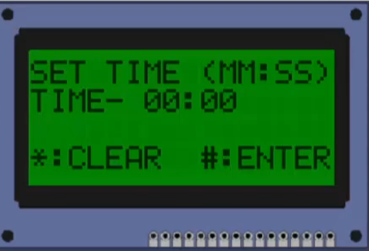
THE MICRO MODE
On pressing key 1 in the matrix keypad, MICRO MODE is selected.
The CLCD displays the power.
CLCD prompts the user to enter the cooking time.
‘*’ button clears the time .
‘#’ button confirms the time and start the cooking.

Slide 9
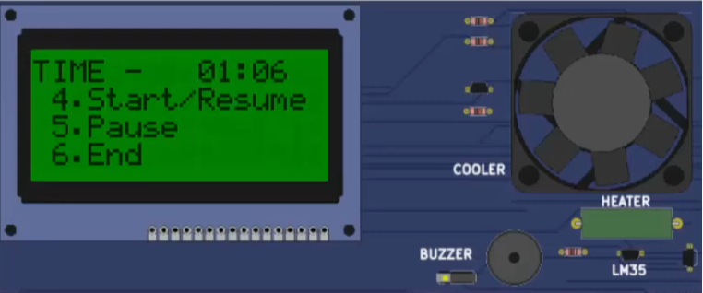
Timer starts
Fan starts
Key 4 of matrix keypad adds 30s to the current cooking time
Key 5 pauses the cooking (timer and fan)
Key 4 also resumes the cooking
Key 6 ends the cooking

Slide 10
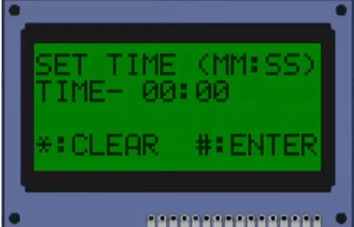
2. THE GRILL MODE
On pressing key2 in the matrix keypad, GRILL MODE is selected
CLCD prompts the user to enter the cooking time
‘*’ button clears the time
‘#’ button confirms the time and starts cooking

Slide 11
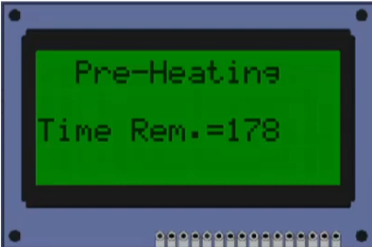
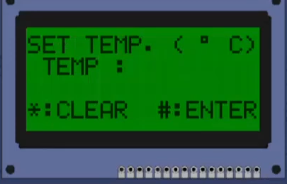
3.THE CONVECTION MODE
On pressing the key 3 in the matrix keypad, CONVECTION MODE is selected
CLCD prompts the user to enter the cooking temperature (c)
‘*’ button clears the temperature
‘#’ button confirms the temperature
Oven starts preheating with the given temperature for 3min
Following which prompts the user to enter the cooking mode

Slide 12
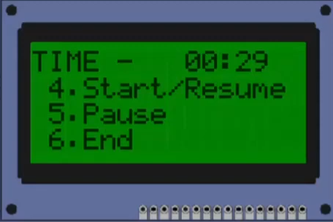
4. START MODE
On pressing key 4 in matrix keypad, START MODE is selected
cooking time is set to 30s and cooking starts automatically

Slide 13
INTERFACING

Slide 14
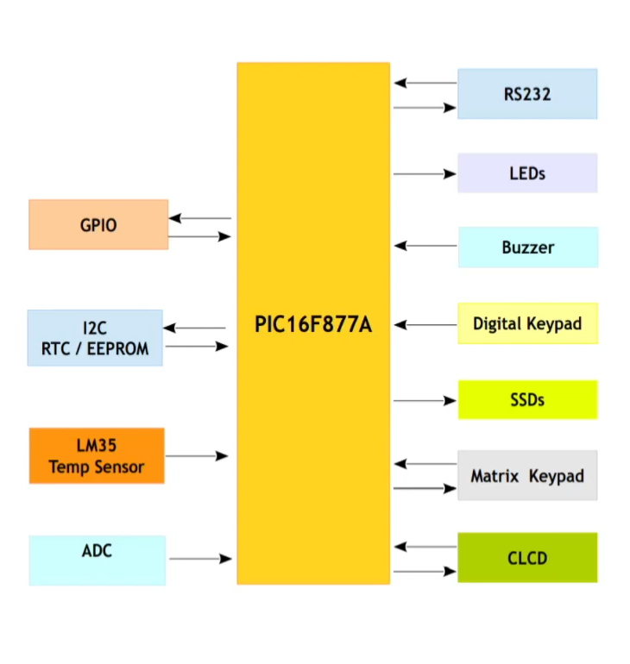
PIC16F877A
Features
PIC16F877A operating frequency
of DC-20MHz
5 I/O ports
15 interrupts
3 timers
Flash memory 8kb
Data memory 368kb

Slide 15
1. CLCD
CLCD based HD44780 display controller
CLCD has 2 communication modes: we use 16x4 in 4 bit mode
Used to display the messages
connected to PORT D
Enable pin 1 of PORT E
RS PIN 2 of PORT E

Slide 16
2. MATRIX KEYPAD
Edge/State triggering mode
Used to select cooking modes and enter time and temperature values
Connected to PORT D(rows) and PORT B(columns)

Slide 17
3.TIMER
Timer 2 is an 8 bit timer with prescaler and postscaler. The TMR2 register is readable and writable and is cleared on any device Reset
4.INTERRUPTS
An interrupt is occurs when timer 2 register overflows
BUZZER AND FAN
Buzzer – connected to pin 1 of PORT C
Fan – connected to pin 2 of PORT C

Slide 18
PROJECT DEMONSTRATION

